Slide 1


Slide 2



@EdCDCS
For all events, news, and support: cdcs.ed.ac.uk

Slide 3
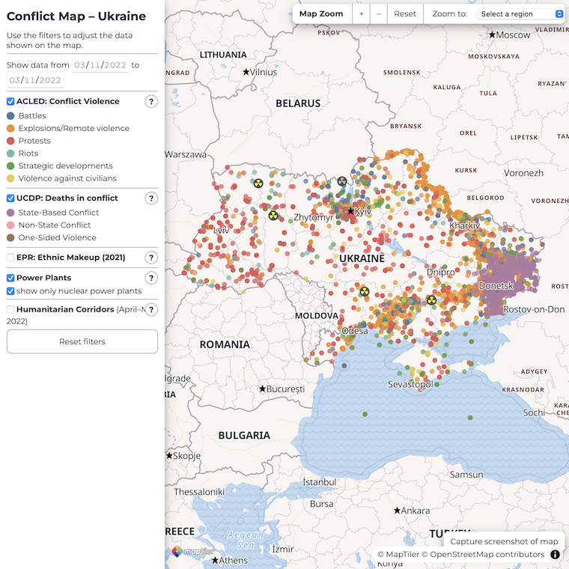
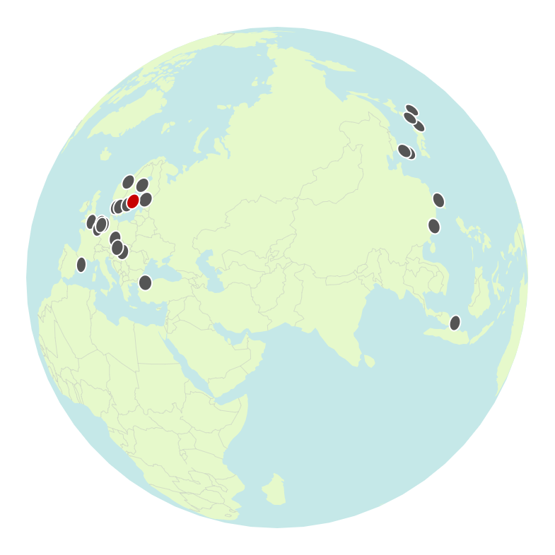

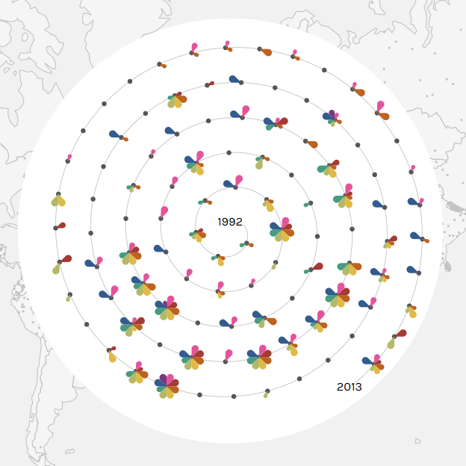
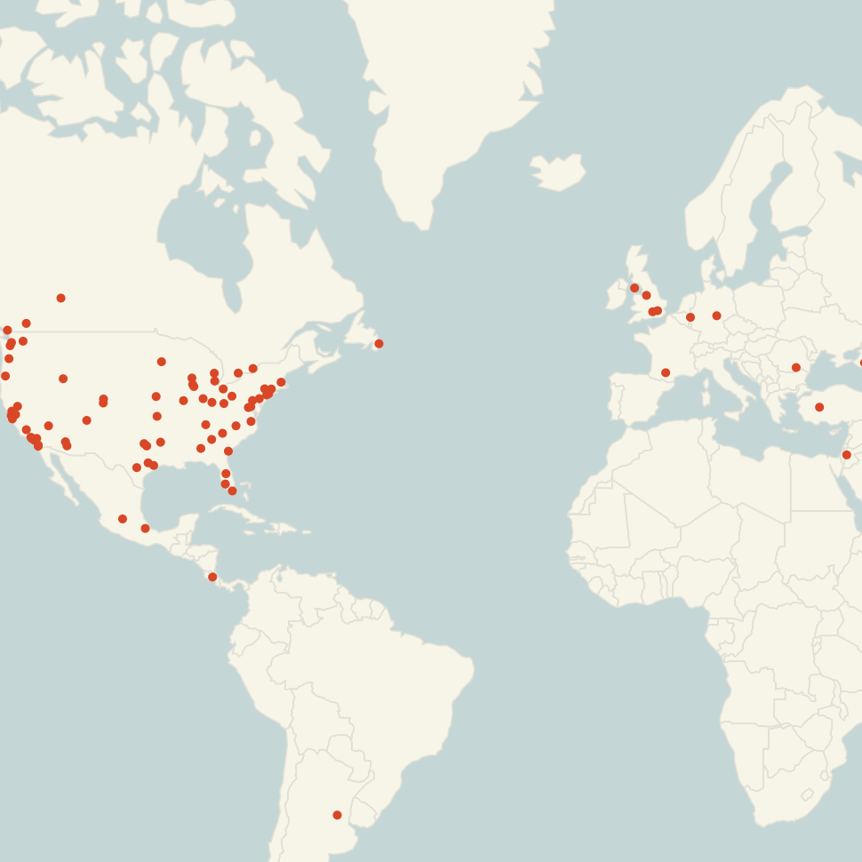
Welcome!
Sarah Schöttler
PhD student in data visualization & visualization developer
https://sarahschoettler.com/
Notes:
A/S

Slide 4
Schedule for Today
Find these slides online:
github.com/DCS-training/ interactive-web-maps
10:00 Welcome & Introduction
10:10 Presentation: Understanding your project requirements and constraints
10:20 Discussion: What are you looking to achieve?
10:50 Break
11:00 Presentation: Tools and Example Maps
11:15 Time to try out mapping tools, supported by the trainer
12:00 Closing
Notes:
S

Slide 5
Part I: Understanding your requirements and constraints

Slide 6
Requirements
What does your data look like?
large or small dataset
complex & multi-variate or simple
clean or containing errors
area or point data, both, or something else (e.g. networks)?
How will your map be used?
publicly shared, many users
internal, fewer users
Do you have specific design requirements?
style guide (colors/fonts) you need to conform to
accessibility

Slide 7
Constraints
How much time do you have?
short-term
long-term
Who is involved?
just you?
a larger team?
What skills do you (+ team) have?
Programming
How easily do you usually learn new software?
How much funding do you have?
none
a little bit – could pay for a software license
significant – could hire a developer to create custom maps
one-off or ongoing?

Slide 8
Let’s discuss!
Requirements
Constraints
What does your data look like?
large or small dataset
complex & multi-variate or simple
clean or containing errors
area or point data, both, or something else (e.g. networks)?
How will your map be used?
publicly shared, many users
internal, fewer users
Do you have specific design requirements?
style guide (colors/fonts) you need to conform to
accessibility
How much time do you have?
short-term
long-term
Who is involved?
just you?
a larger team?
What skills do you (+ team) have?
Programming
How easily do you usually learn new software?
How much funding do you have?
none
a little bit – could pay for a software license
significant – could hire a developer to create custom maps
one-off or ongoing?

Slide 9
Break

Slide 10
Part II: Tools & Examples

Slide 11
5 No-code tools

Slide 12
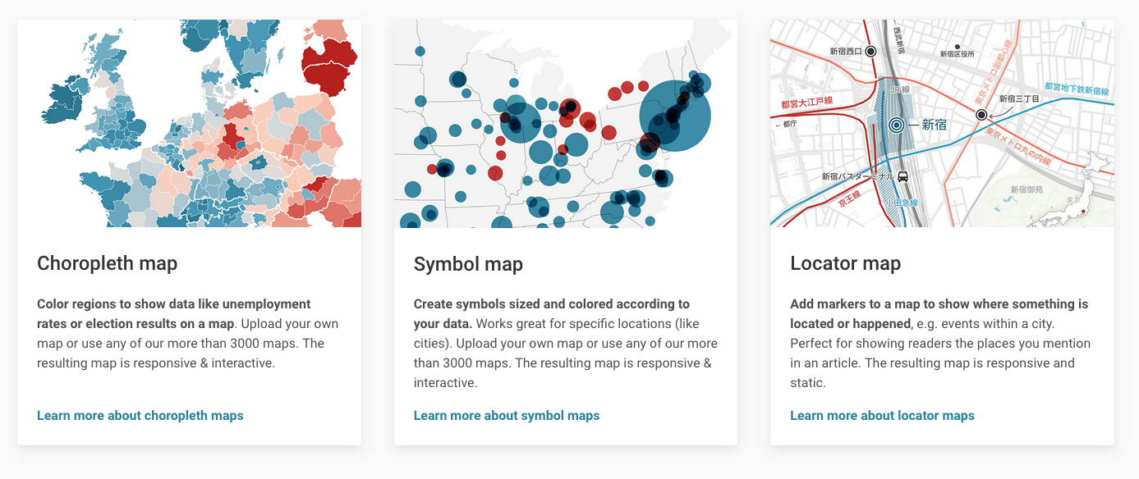
Datawrapper (free)
https://app.datawrapper.de/select/map

Slide 13
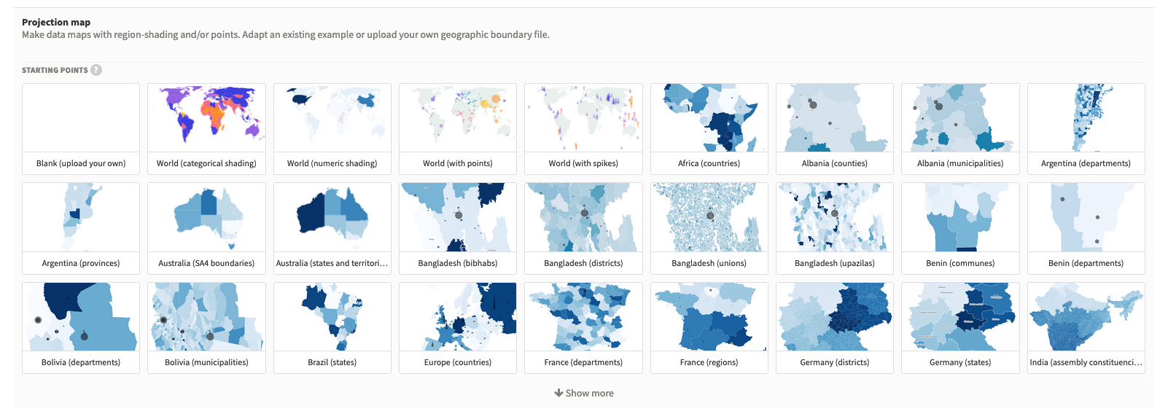
Flourish (free)
https://app.flourish.studio/templates#template-projection-map

Slide 14
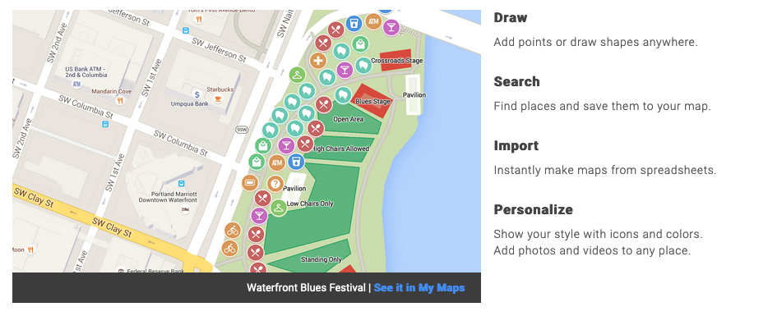
Google My Maps (free)
https://www.google.com/maps/about/mymaps/

Slide 15
ArcGIS Online (paid)
https://www.arcgis.com/

Slide 16
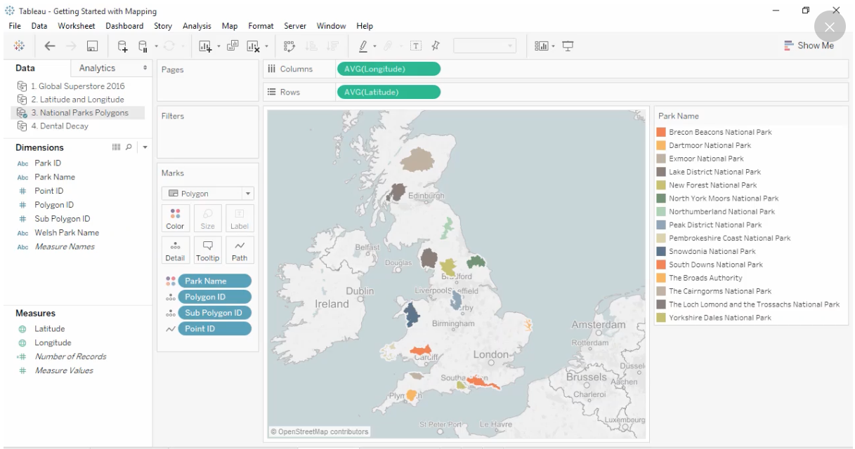
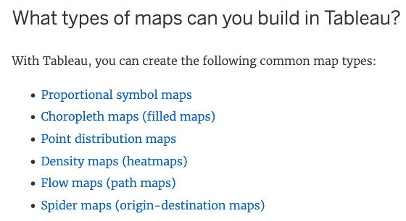
Tableau (paid)
https://www.tableau.com/solutions/maps

Slide 17
5 JavaScript libraries

Slide 18
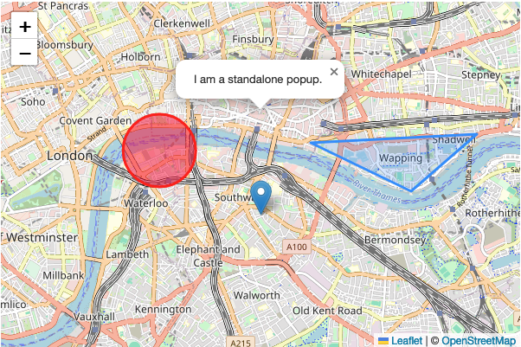
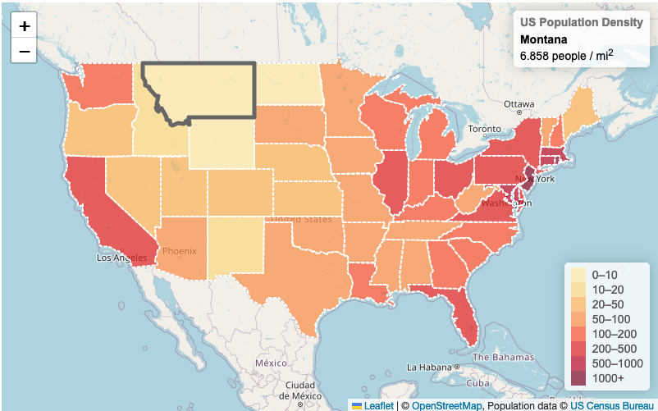
Leaflet (free/open-source)
https://leafletjs.com/
https://leafletjs.com/examples/choropleth/
https://leafletjs.com/examples/quick-start/

Slide 19
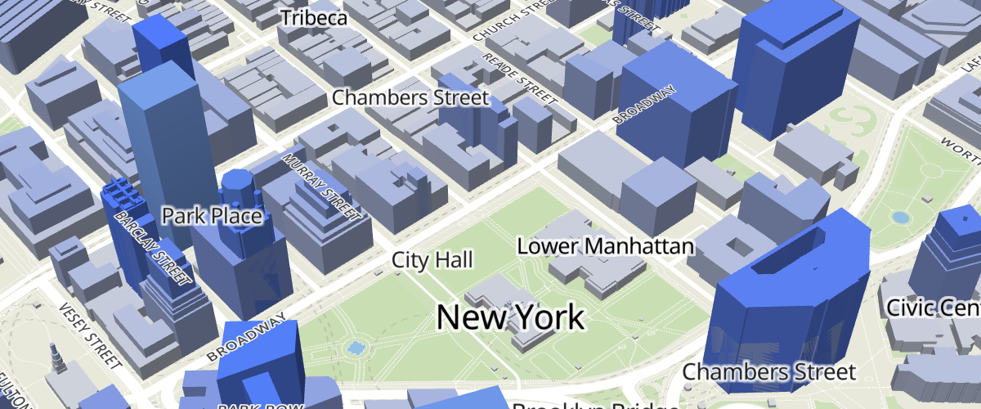
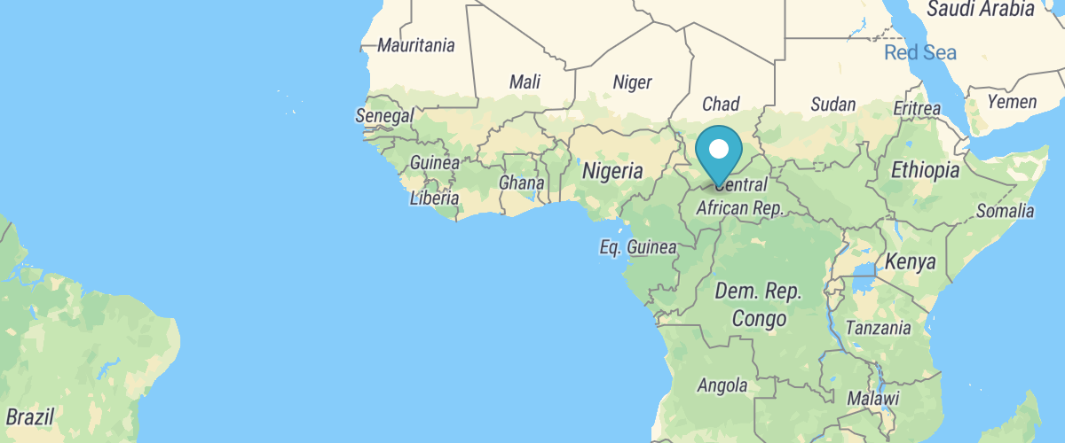
MapLibre (free/open-source)
https://maplibre.org/maplibre-gl-js/docs/
https://maplibre.org/maplibre-gl-js/docs/examples/

Slide 20
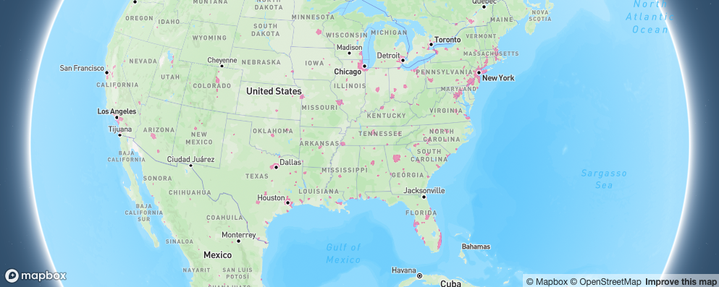
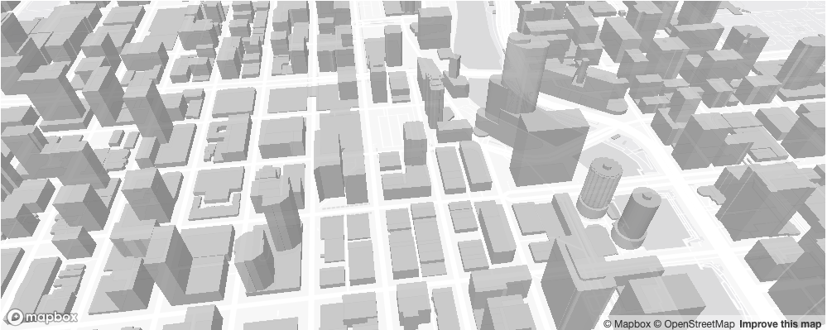
MapBox (free/paid)
https://docs.mapbox.com/mapbox-gl-js/guides/
https://docs.mapbox.com/mapbox-gl-js/example/animate-camera-around-point/
https://docs.mapbox.com/mapbox-gl-js/example/geojson-layer-in-stack/

Slide 21
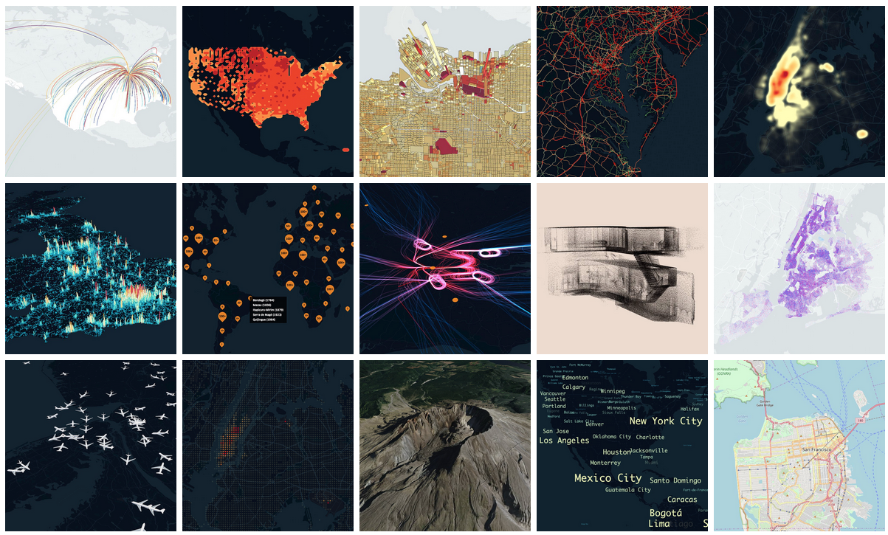
DeckGL (free/open-source)
https://deck.gl/
https://deck.gl/examples

Slide 22
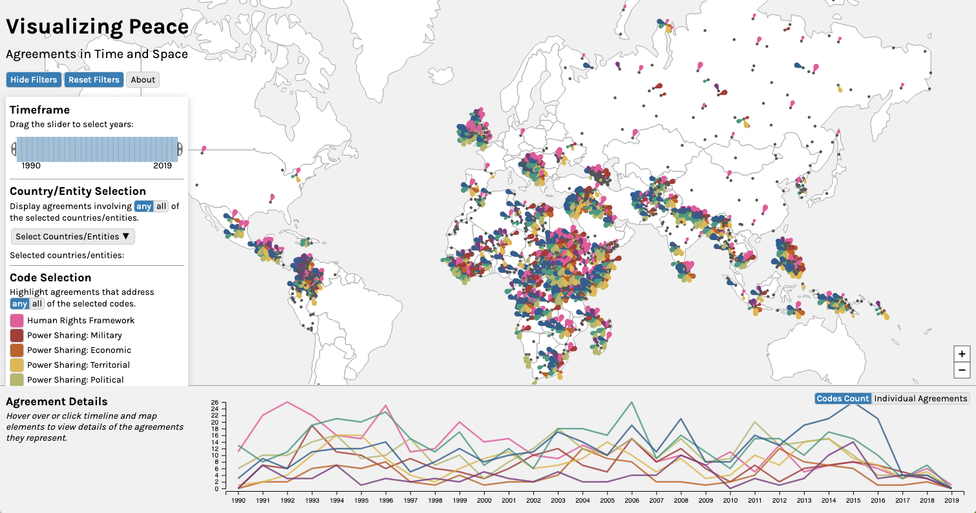
D3 with d3-geo (free/open-source)
https://d3js.org/d3-geo
https://peacerep.github.io/pax-map/

Slide 23
Let’s try out some tools!
Find links to all tools (and these slides) here: https://github.com/DCS-training/interactive-web-maps
Try to find other people interested in the same tools and work together
Ask me if you have any questions, want advice, or need help!

Slide 24
Thank you!
Feedback form: see follow-up email
Link to these slides and a list of all tools we covered: https://github.com/DCS-training/interactive-web-maps

